Slide 1

Testing The Talabat Mobile Application
NORTHWIND TRADERS

Slide 2
Agenda
Test Plan Summary
Main Test Flow
Bug& Bug Report example
Results & Suggestions
Youssef Zaafan Atiya
DATE 27/8/2025

Slide 3
Test Plan Summary we focused on five main types o testing
Functional Testing
Usability Testing
Payment Testing
4
3
2
1
Exploratory Testing
5
Compatibility Testing

Slide 4
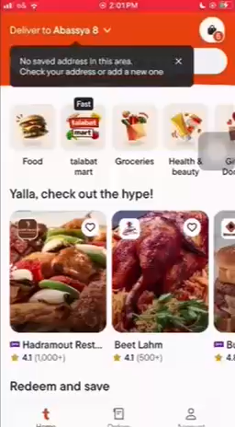
Main Test Flow

Slide 5
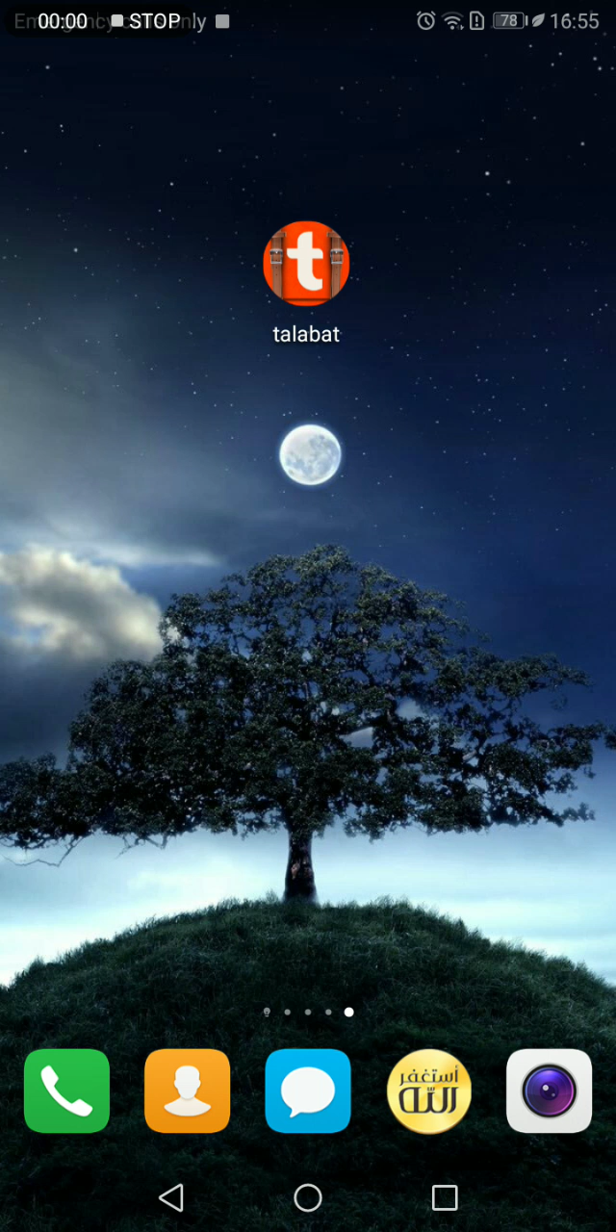
Bug example

Slide 6
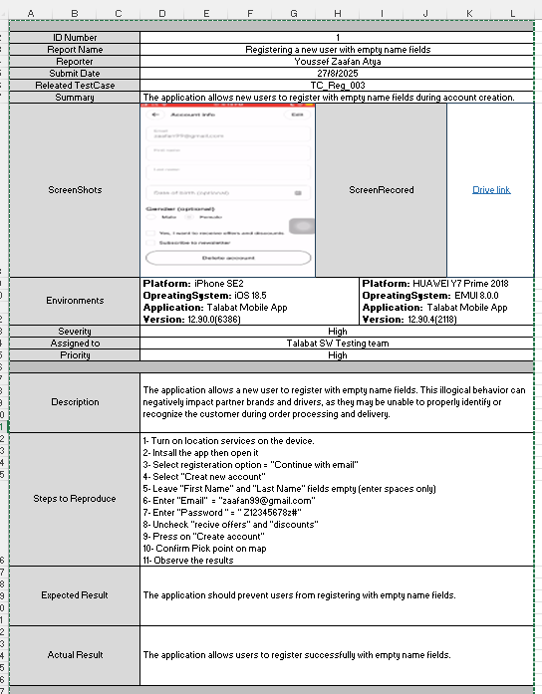
Bug Report example

Slide 7
Results & Suggestions
In total, we tested over 30 cases, with a success rate of 77%.
My suggestions include:
Improving address validation
Enforce users to keep the location serves turned on while ordering
Introduce a validation mechanism between app country setting and device location.
Before order acceptance, the restaurant should confirm the order by contacting the customer.

Slide 8
Thank you for watching looking forward for your feedback
Youssef Zaafan Atya | LinkedIn

